Slide 1
Optimising Deepfake Detection and Recognition with Deep Learning Techniques
Pranjal Malik
Tuesday, 13th August 2024
presented in partial fulfilment of the requirement for the degree of MSc in Data Science and AI to the School of Engineering, Arts, Science and Technology

Slide 2

Outline
Background/Overview
Problem Statement
Data and Pre-Processing
Proposed Model
Evaluation
Discussion and Findings
Conclusion

Slide 3
Background/Overview
What are Deepfakes?
AI-generated synthetic media (images or videos).
Often involve face swapping or creating fictitious personas.
Implications of Deepfakes
Privacy & Security Threats: Unauthorised use of individuals' likenesses.
Misinformation Spread: Potential to create and disseminate false information.
Erosion of Trust: Challenges the authenticity of digital media.

Slide 4
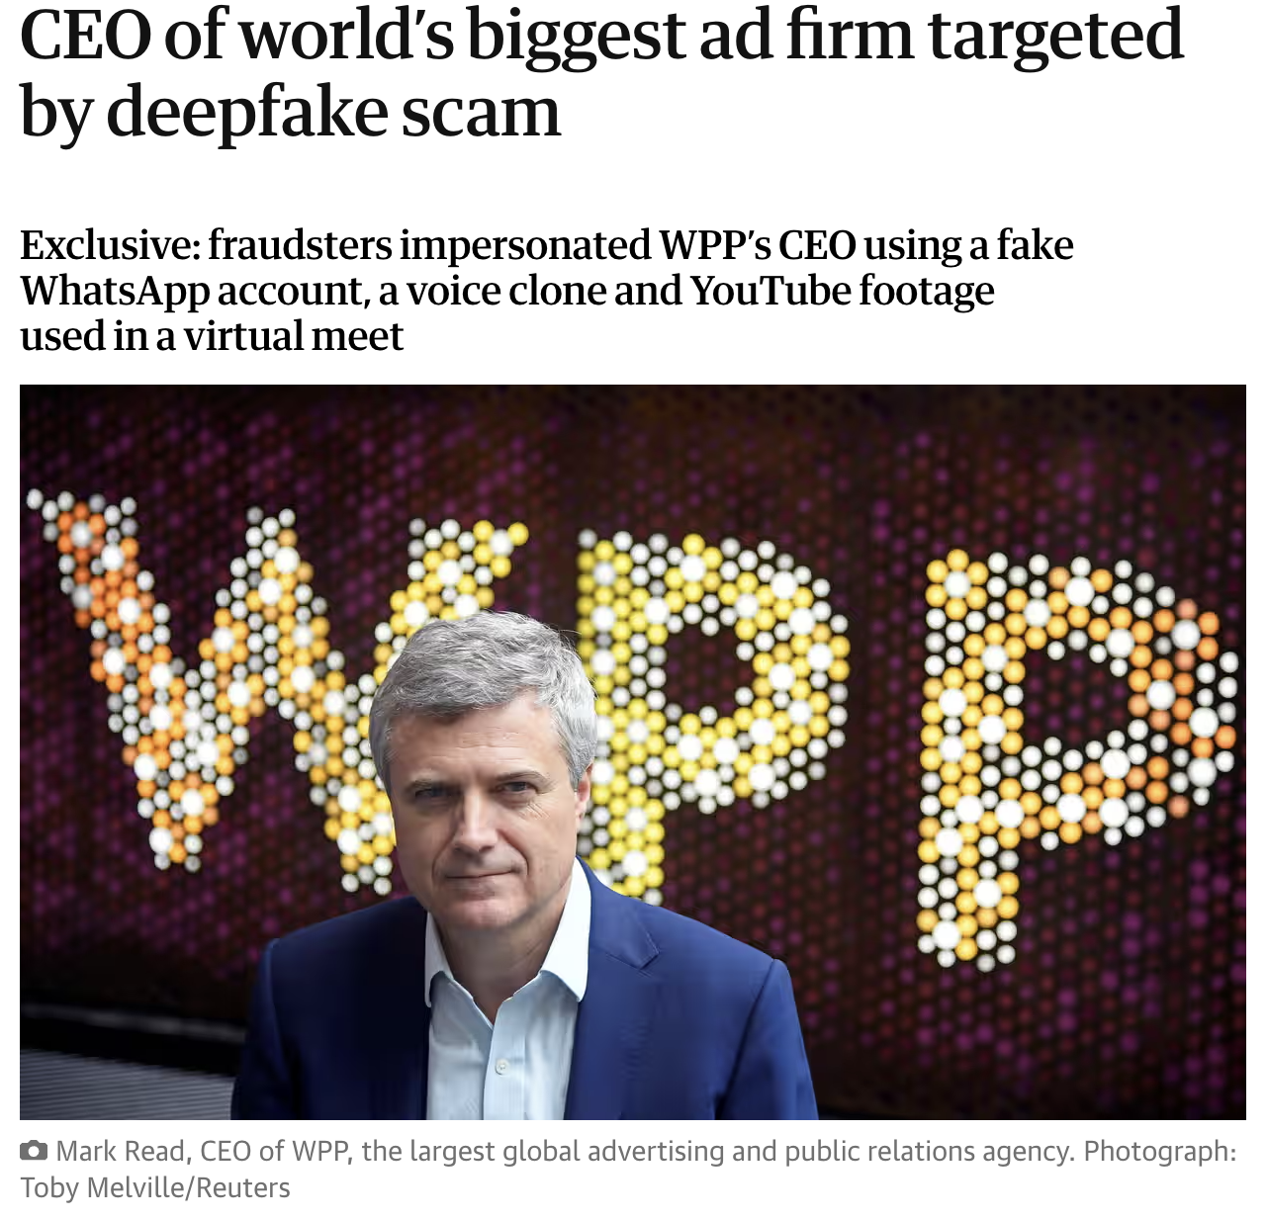
In 2021, a deepfake audio was used to impersonate the voice of a UK-based CEO, leading an employee to transfer £200,000 to a fraudulent account. The convincing nature of the voice deepfake underscored the rising use of this technology in financial crimes and the need for businesses to adopt advanced recognition tools.

Slide 5
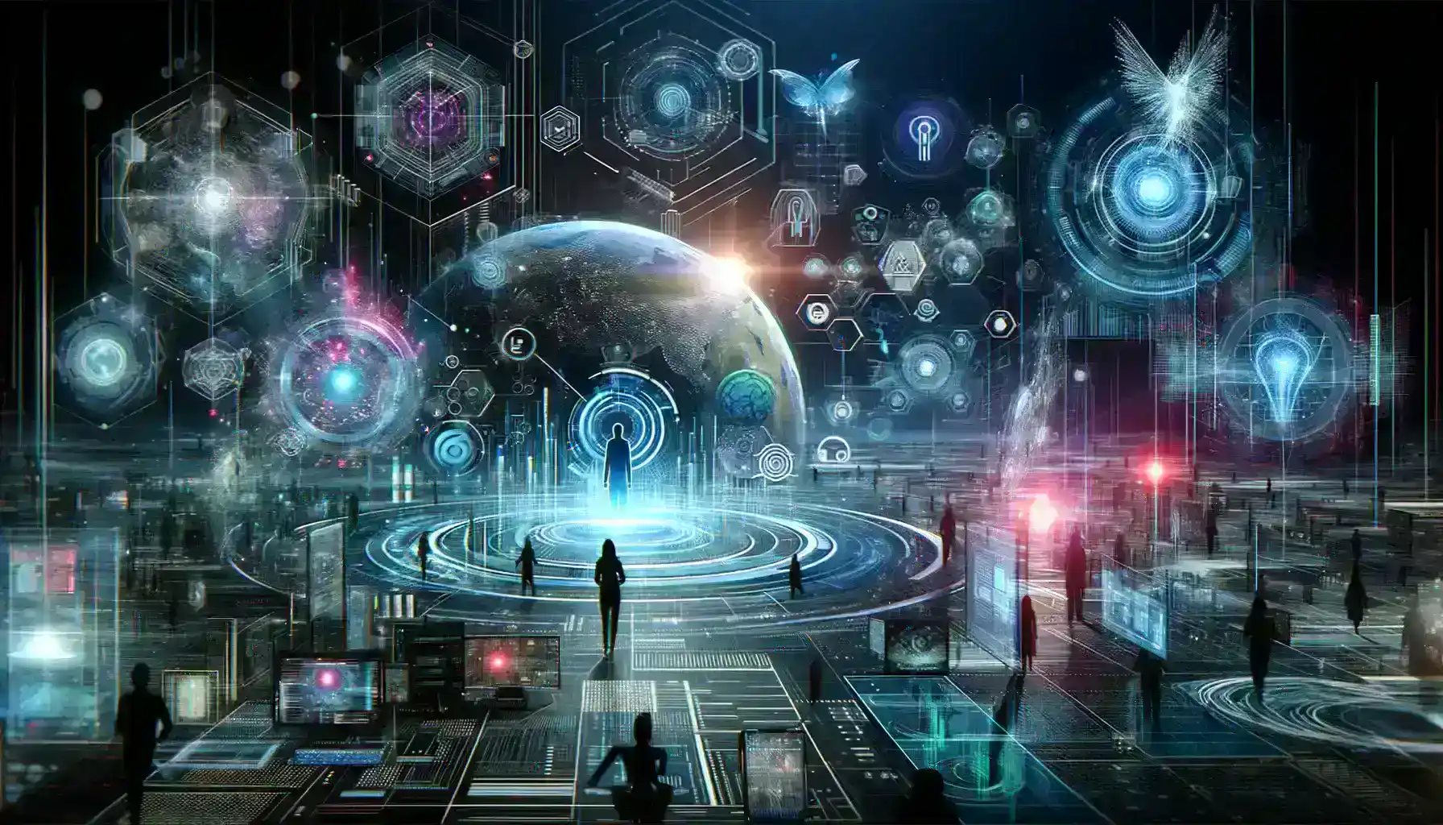
In January 2024, a financial institution in the United States fell victim to a sophisticated deepfake attack where cybercriminals used a fabricated video of the CEO to authorize a fraudulent transfer of a significant sum of money. The video was so convincing that it led the employees to process the transaction without suspicion. This incident highlighted the increasing use of deepfake technology in corporate fraud, posing severe financial risks and emphasizing the need for enhanced security measures within organizations.
This case is part of a broader trend where deepfakes are being exploited for cybercrimes, including phishing scams and impersonation, threatening the integrity of both personal and corporate data .
Reference: Cyber Threats in 2024: Navigating the Deepfake Dilemma. [online] HyScaler. Available at: <https://hyscaler.com/insights/cyber-threats-in-2024-deepfake-dillema/>

Slide 6
Problem Statement
Detection Challenges
High Realism: Advanced techniques make deepfakes increasingly indistinguishable.
Rapid Evolution: Continuous improvements in generation methods outpace detection capabilities.
Consequences of Undetected Deepfakes
Public Mistrust: Undermines confidence in media and information sources.
Geopolitical Risks: Potential misuse in political manipulation and misinformation campaigns.
Research Focus
Objective: Develop robust detection methods to counteract deepfake threats.
Approach: Leverage deep learning architectures like ResNet50 and DenseNet121.

Slide 7
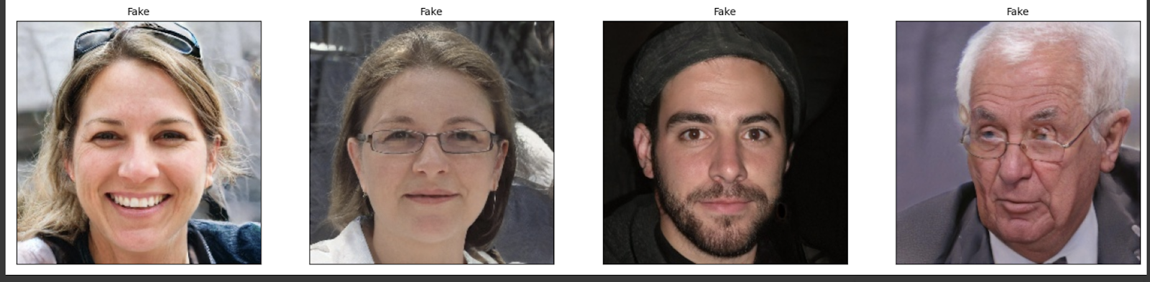
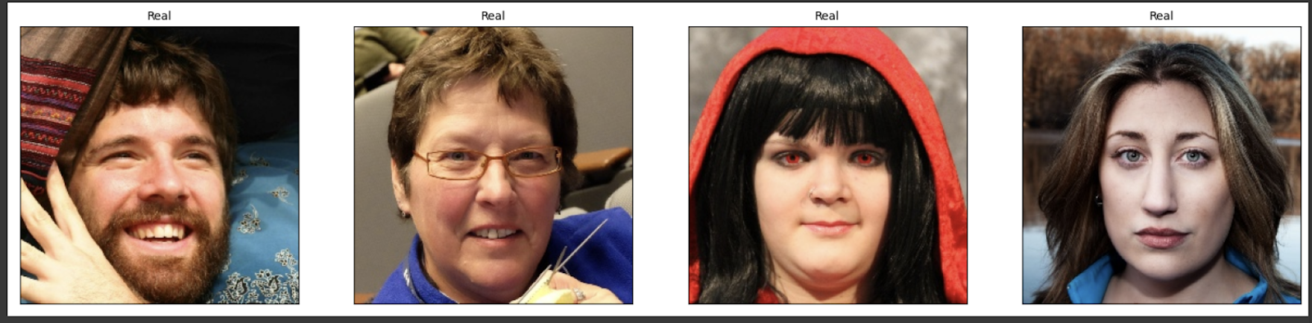
Sample of images from the dataset used in the thesis

Slide 8
Data and Pre-Processing
1. Data Collection
Dataset: 140k Real and Fake Faces
70,000 real faces (Flickr dataset)
70,000 fake faces (StyleGAN generated)
2.Pre-Processing
Balancing: Equalized the number of real and fake samples.
Splitting: Divided dataset into training, validation, and test sets.
Face Extraction: Detected and extracted faces from images.
Normalisation: Applied normalisation, data augmentation, and noise addition.
Data Separation: Categorized images into real and fake.

Slide 9
Proposed Model
3. Model Selection
Architectures:
ResNet: Deep residual learning for robust feature extraction.
DenseNet: Enhanced gradient flow and parameter efficiency.
4. Data Preparation
Balanced real vs. fake datasets to avoid model bias.
Extracted and normalised faces to standardise inputs.
5. Model Training
Trained ResNet and DenseNet on the pre-processed dataset.
Applied iterative learning with validation to optimise models.

Slide 10
Evaluation
Testing & Validation:
Tested models on unseen data to evaluate generalisation.
Fine-tuned models to improve performance in real-world scenarios.
Evaluation Metrics Used:
Accuracy: Measures the proportion of correctly identified instances.
AUC Score: Represents the ability of the model to distinguish between classes.
Precision: Indicates the accuracy of positive predictions.

Slide 11
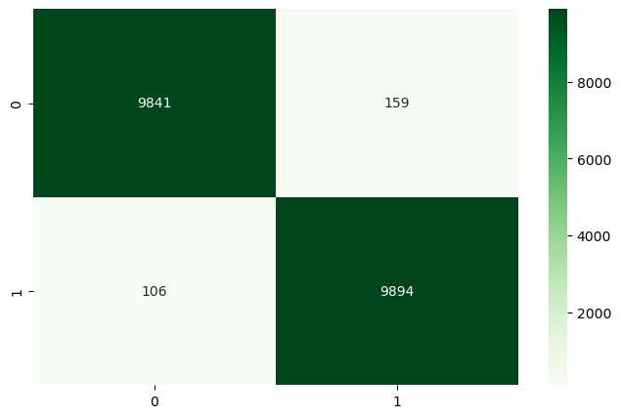
DenseNet121 Model
Accuracy: Achieved competitive accuracy of 98.87%.
Precision: Precision of 0.9842, slightly lower than ResNet but still strong.
Fig : DenseNet Confusion Matrix

Slide 12
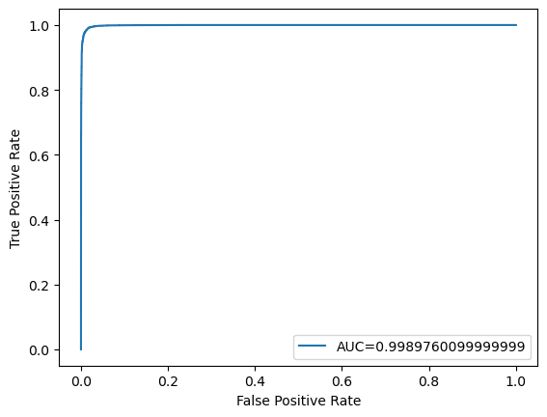
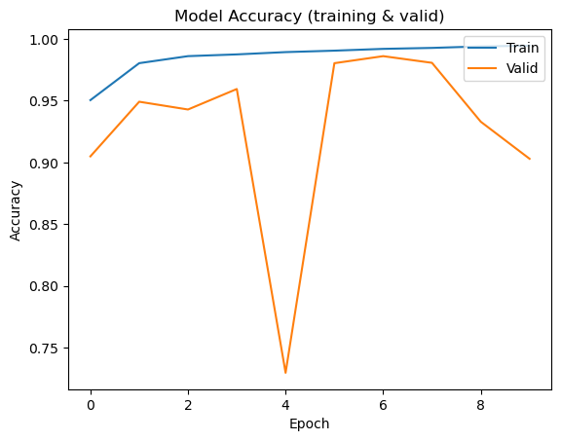
AUC Score: Improved AUC score of 0.998976, indicating excellent classification ability.
Limitations: Despite a higher AUC, DenseNet showed variability in validation accuracy, suggesting potential overfitting.

Slide 13
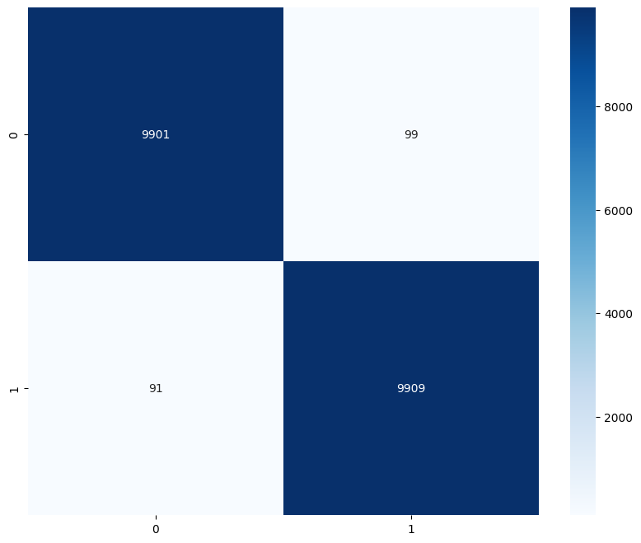
ResNet Model:
AUC Score: Recorded an AUC score of 0.98, reflecting a strong capability in distinguishing real from fake instances.
Precision: High precision of 0.9901, indicating excellent reliability in detecting deepfakes.
Limitations: The model is highly accurate but has a slightly lower AUC compared to DenseNet, suggesting some room for improvement in handling borderline cases.

Slide 14
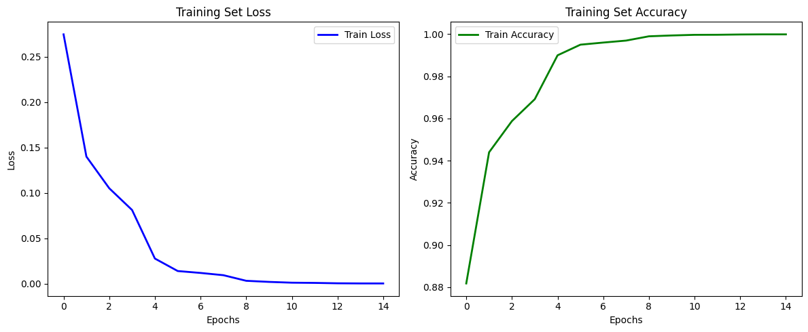
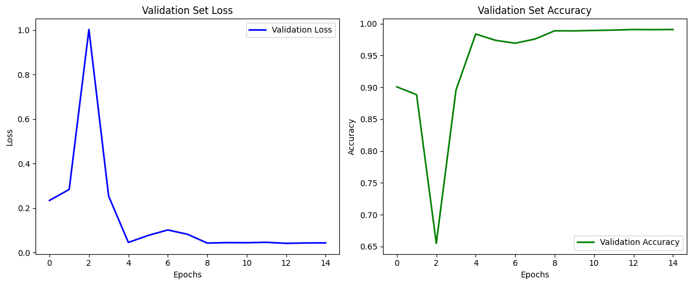
Accuracy: Achieved an impressive accuracy of 99.05%.
The validation accuracy mirrors the erratic pattern seen in the loss, starting around 90%, dropping sharply, then recovering and stabilizing around 98%.
Fig: Accuracy and Loss Plot ResNet
Fig: Validation Accuracy and Loss Plot ResNet

Slide 15
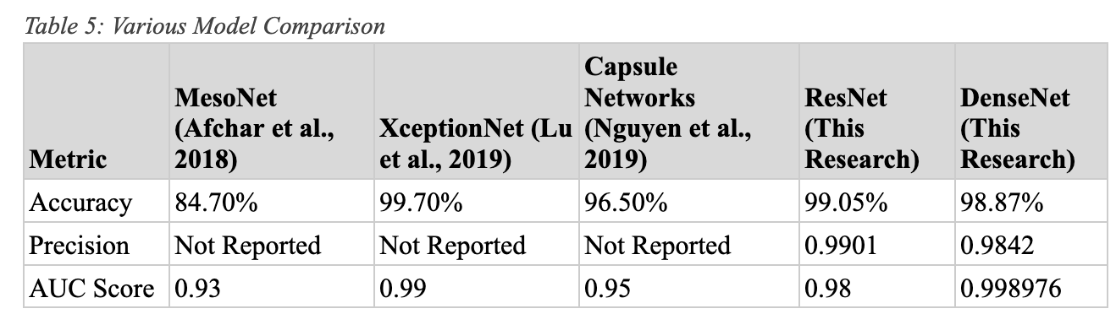
Discussion and findings
XceptionNet stands out with the highest accuracy at 99.70% and a strong AUC score of 0.99.
ResNet and DenseNet (from this research) both show competitive accuracy and excellent AUC scores, indicating strong performance.
MesoNet has the lowest accuracy at 84.70% and an AUC score of 0.93, making it less effective compared to the other models.
Precision was only reported for ResNet and DenseNet in this research, with ResNet slightly outperforming DenseNet.

Slide 16
Conclusion
ResNet50: Achieved superior accuracy (99.05%) and robustness, particularly in detecting complex deepfakes.
DenseNet: Demonstrated strong generalization across diverse datasets with exceptional accuracy (98.87%).
Challenges Identified:
Overfitting: Noted when training densenet model on homogeneous datasets, suggesting the need for more diverse training data.
Future Directions:
Optimization: Focus on reducing computational load without compromising performance and further research to enhance DenseNet’s accuracy while maintaining its efficiency.
XAI: Integrating explainable AI to justify why the image is real or fake?
Impact: Contributing to improved deepfake detection technology with practical applications in security, media integrity, and ethical AI.

